Slide 1
From Super Instruments to Interactive Operas
Maria Kallionpää, composer and pianist

Slide 2
Projects
Past project, University of Oxford. Piano as a super instrument
-> continued with:
Climb! – for Disklavier and Interactive System. A collaboration between Maria Kallionpää and the Mixed Reality Laboratory of the university of Nottingham
Current project: Interactive Opera (in collaboration with Dr. Alan Chamberlain and the MRL, Nottingham). Machine learning, Virtual Reality technologies, interactive film, audience participation…

Slide 3
Related Work
CLIMB: A Virtuoso Composition for Disklavier and Interactive System
Performance Interactions and Systems
Real-time Score Display
Structuring Music Information

Slide 4
Climb! For Disklavier and Interactive System
Consists of: Disklavier, live system, interactive visuals, smartphone application, web archive
Creative process: development of the artistic work and technology being “a two-way street”
Trial and error: a process of spotting errors in music/system
Non-linear form: the composer being aware of the structure at all times
Disklavier as a super instrument. Adding technical and expressive potential that a human pianist could normally not achieve

Slide 5
Design: Climb!
Interactive ‘game’ composition
Metaphor of climbing a mountain, multiple paths, weather etc
Instrumental forces - solo piano, Disklavier, electronics (audio processing), visuals
Identified requirements - triggering interactions (Disklavier playback, DSP processing, dynamic notation, visuals
Summit
Event 5a
Event 5b
Event 5c
Event 4a
Event 4b
Event 4c
Path A
Path B
Path C
Event 3a
Event 3b
Event 3c
Path A
Path B
Path C
Event 2a
Event 2b
Event 2c
Path A
Path B
Path C
Event 1a
Event 1b
Event 1c
Basecamp
Choice of three paths

Slide 6
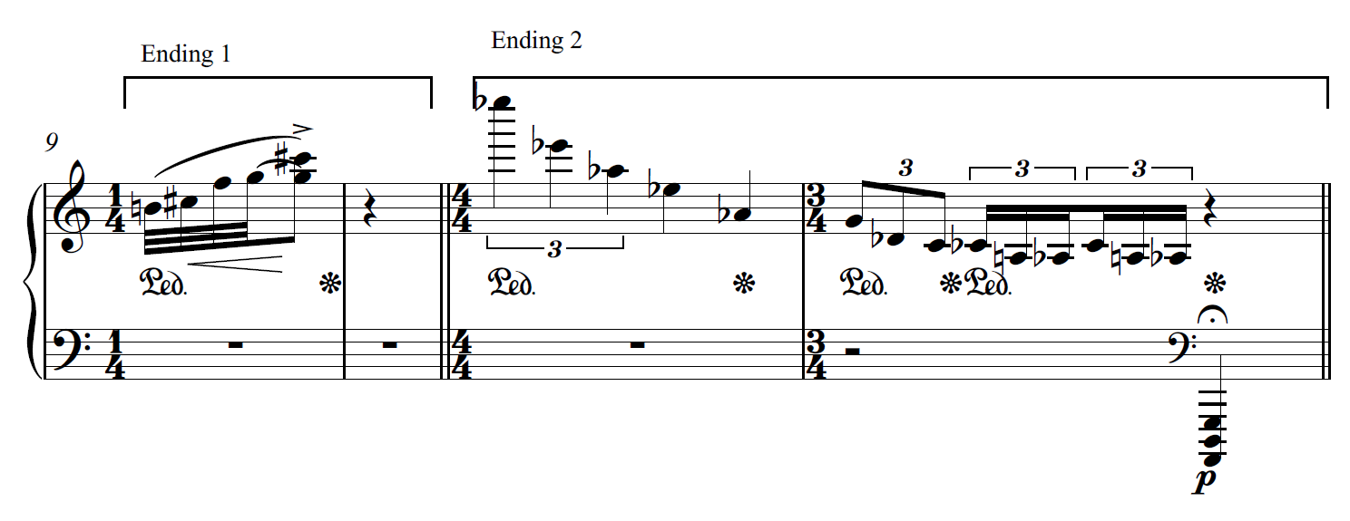
An example code...

Slide 8
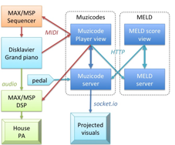
Implementation

Slide 9
Works
Climb! – for Disklavier and Interactive System. A collaboration between Maria Kallionpää and the Mixed Reality Laboratory of the university of Nottingham. Web Archive:
http://music-mrl.nott.ac.uk/1/archive/explore/Climb
https://www.youtube.com/watch?v=tHA78OwtKqw
Chrysalis: Magnetic Resonator Piano https://www.youtube.com/watch?v=BziANtuSVnA

Slide 10
Climb! For Disklavier and Interactive System
https://www.youtube.com/watch?v=xH7r4agzrQs&list=PL8qKIYmHEMnVXAlGyRW6vsXZXrdEVF24S&index=2
2nd performance, June 8th 2017 (ca. from 12:00)

Slide 11
Opera as an Evolving Artform
New technologies (Artificial intelligence, robotics, Virtual Reality (VR), extended instruments…) bringing in new modes of expression
Use of performance based software (Max/MSP, Ableton Live) enabling the intertwining of musical composition and theatrical performance
New composition techniques enabled (algorithmic composition techniques, non-linearity of form
Opera as a new-media research platform that can allow researchers to develop new technologies and interactional techniques that at a high-level explore the interplay between audience, performance, composition and staging

Slide 12
State of the Art in Contemporary Opera
The genre of contemporary opera sets its special challenges to the composers, performers, and producers, as well as to the intendents of opera houses
How to obtain new audiences and at the same time keep the current ones interested?
Composers interested in looking for musical language and technical means
Although traditional means (sonata, symphony) often disliked, operas are still being composed an listened -> successful implementation of new technologies and expressive ideas keeping opera “fresh”

Slide 13
State of the Art in Contemporary Opera
Sir Maxwell Davies : “Miss Donnithorne ́s Maggot” – Themes: memories and forgetting. Fragmentary storyline
Van der Aa: ”Blank Out”, “Sunken Garden”, “The Book of Disquiet”: the dramatic contents are communicated with the help of 3D projection techniques in combination with live performance, pre-recorded musical material, and sound processing
an immersive theatrical experience.
Miika Hyytiäinen: Omnivore (2012). The world´s 1st mobile phone opera. “the whole script, form, musical expression, and in general the way of making an opera have been totally re- discovered” – Jaakko Nousiainen, the director

Slide 14
Maria Kallionpää: SHE (2016-2017)
Commissioned by Fabbrica Young Artists ́ Development Program of Opera di Roma, premiered in October 2017 at Teatro Nazionale
Scored for four soloists, middle sized orchestra, magnetic resonator piano, and theremin
Based on Henry Rider Haggard´s adventure/time travel novel “She”
Libretto by Stefano Pintor (La Scala)
Theremin, magnetic resonator piano underlining the divine characteristics of “Ayesha”
Extended instruments and electronic solutions helped to obtain more convincing expressive and artistic results
Enabling technical and expressive means that would not be accessible by human musicians playing regular concert instruments.
Gasselseder: the first ever VR-recording (in sound and video, 360°) of an entire opera , 11th Oct 2017
https://www.youtube.com/watch?v=q4BwXENRw7E (archive copy)

Slide 15
Is it “different” to write an opera?
In essence similar to writing any vocal compositions for soloists and an orchestra (depending on the composer´s experience with writing vocal music)
Communicating the libretto: the text defines the dramatic structure and the form of the composition
Common problem: too “wordy” librettos. Less is more. The text must give enough freedom for the orchestra to tell the story and communicate the atmosphere
The role of the orchestra resembling the camerawork in a film

Slide 16
Maria Kallionpää&Markku Klami: ”Croak” (2017)
The first puppet theatre opera produced in the Nordic Countries
The human-sized puppets specifically manufactured by Viktor Antonov in Sank Petersburg
The stage design and the looks of the puppets evolved alongside the music -> lighter materials used in the puppets, more minimalistic stage design
The sonic effects of the staging affected the overall sonic end result

Slide 17
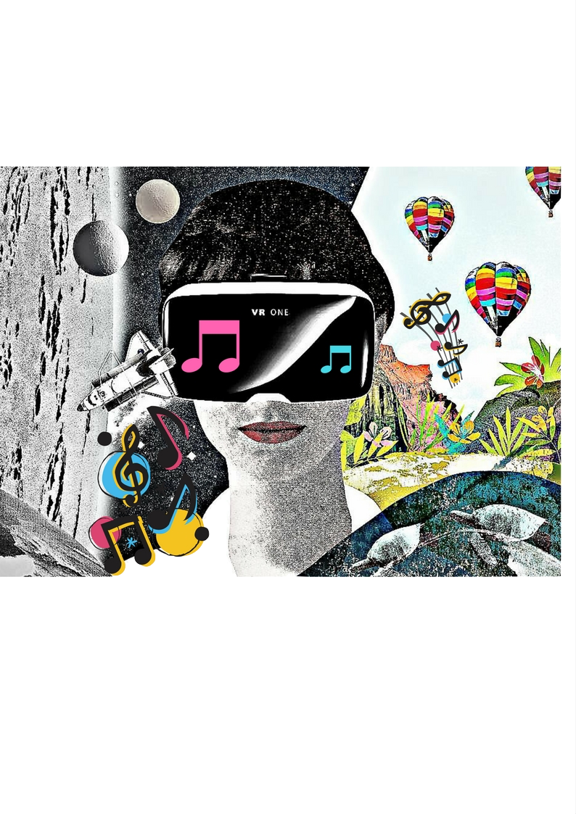

Slide 18
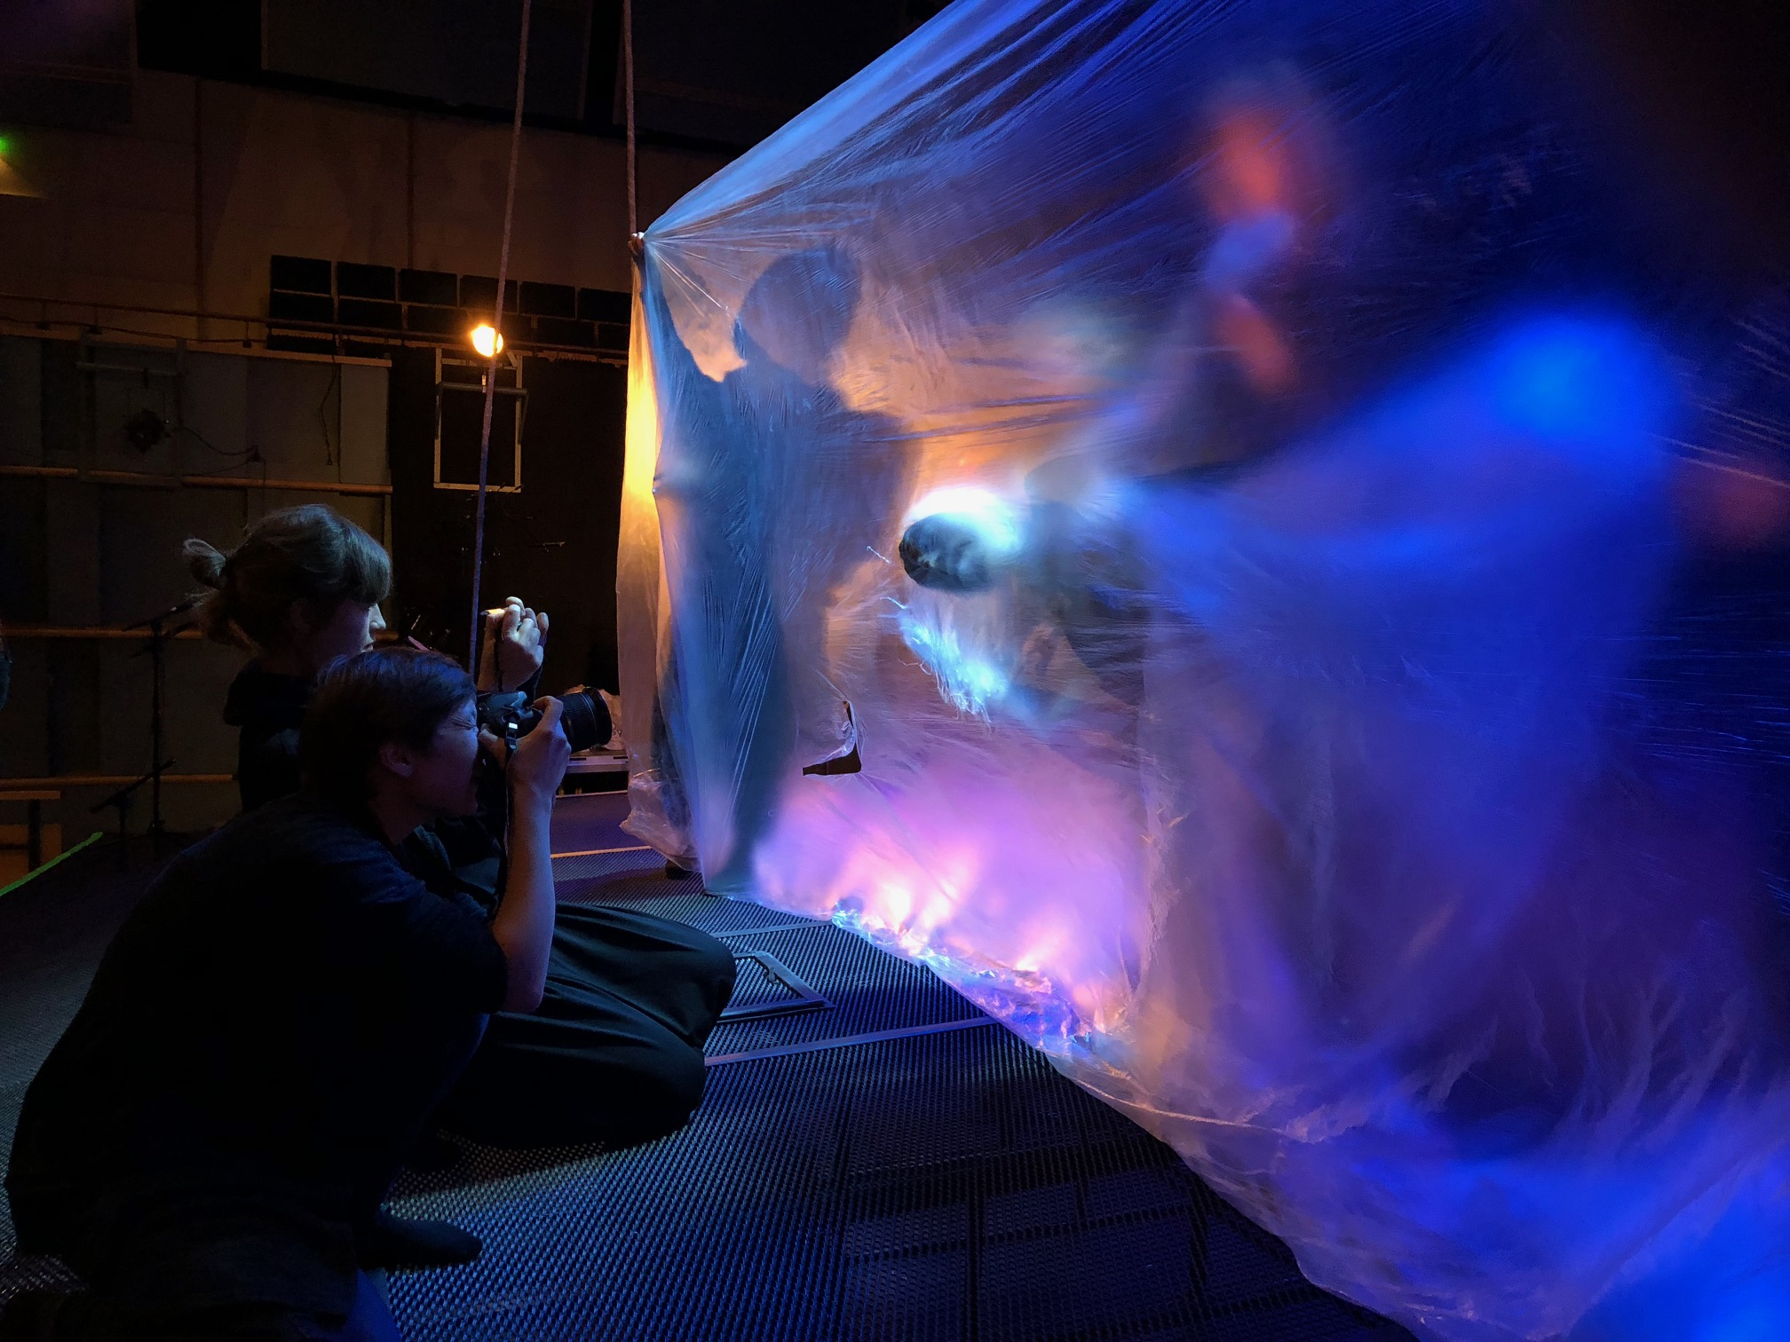

Slide 19
Two composers working together
Keeping the work unified by creating a catalogue of motifs and harmonies
Trying to avoid strong differences of style
Dividing the work in larger sections, usually consisting of more than one consecutive scenes
Diverse characteristics of the scenes facilitated the presence of two different composers -> the structure of an opera defined by the text
Communicating the emotional meaning of the words to the audience

Slide 20
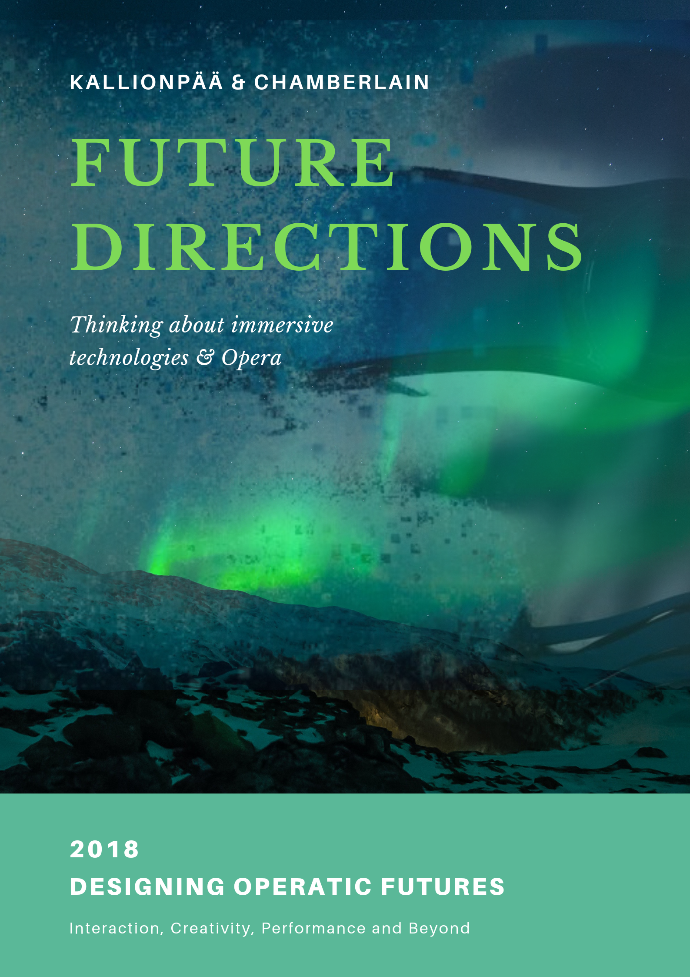

Slide 21
Impact
Renewing classical music culture and reaching out to new audiences by implementing innovative technologies (for example, 360 of freedom recordings of my operas, and a new opera in collaboration with the MRL, Nottingham)
Raising awareness towards environmental issues (sea pollution): opera in progress “Spirits of the Land, Lakes, and Sea”
Opera as a new kind of a research platform

Slide 22
Future Performance Concept
VR & Staged – Performance brings the virtual and real together Multi Sited/Distributed – Performers and viewers in different physical locations
Live and recorded – Live performers/audience engage with live performance/recordings
Non – linear Narrative – allows the audience to engage with different part of the performance at given points

Slide 23
Future Performance Research
Musical Score – Mapping this to interaction (tool) Physical/Digital Artifacts – Is it possible for the audience to engage with physical parts of the ‘scene’? Performer Control – Vocal control of music/scene Co-Design – Understanding how sites work together

Slide 24
Opera as a Digital Research Platform
How will this work? Can we take from Comp Sci, Film & Theatre Studies, How do we archive and re-run non-linear content?.

