Slide 1
HOW DO WE UNDERSTAND TRUST?
Theatre, AI and ‘Ludic Technologies‘
Humanist Perspectives
9th April , 2021

Slide 2
HUMAN-MACHINE TEAMING
Automation aims to reduce operators’ workload, costs and errors while increasing precision. It can help with:
Improved levels of safety
Enormous savings
Operation in safety critical conditions
More eﬀective use of the equipment.
However
The role of humans have moved from direct control to supervision – this creates new challenges.
Cooperation is at the core of Human-Machine Teaming – without this, forming an effective team is impossible.
One of the main goals is to establish strong and cooperative relationships in which people find the system credible, acceptable and usable.
A key factor that influences this is trust.
(Taken from the Hybrid Challenges research plan - written by Debora Zanatto, Mark Chattington, Jan Noyes, Eddie Wilson - which was created to support the project TB-PHASE)
INTERNAL

Slide 3
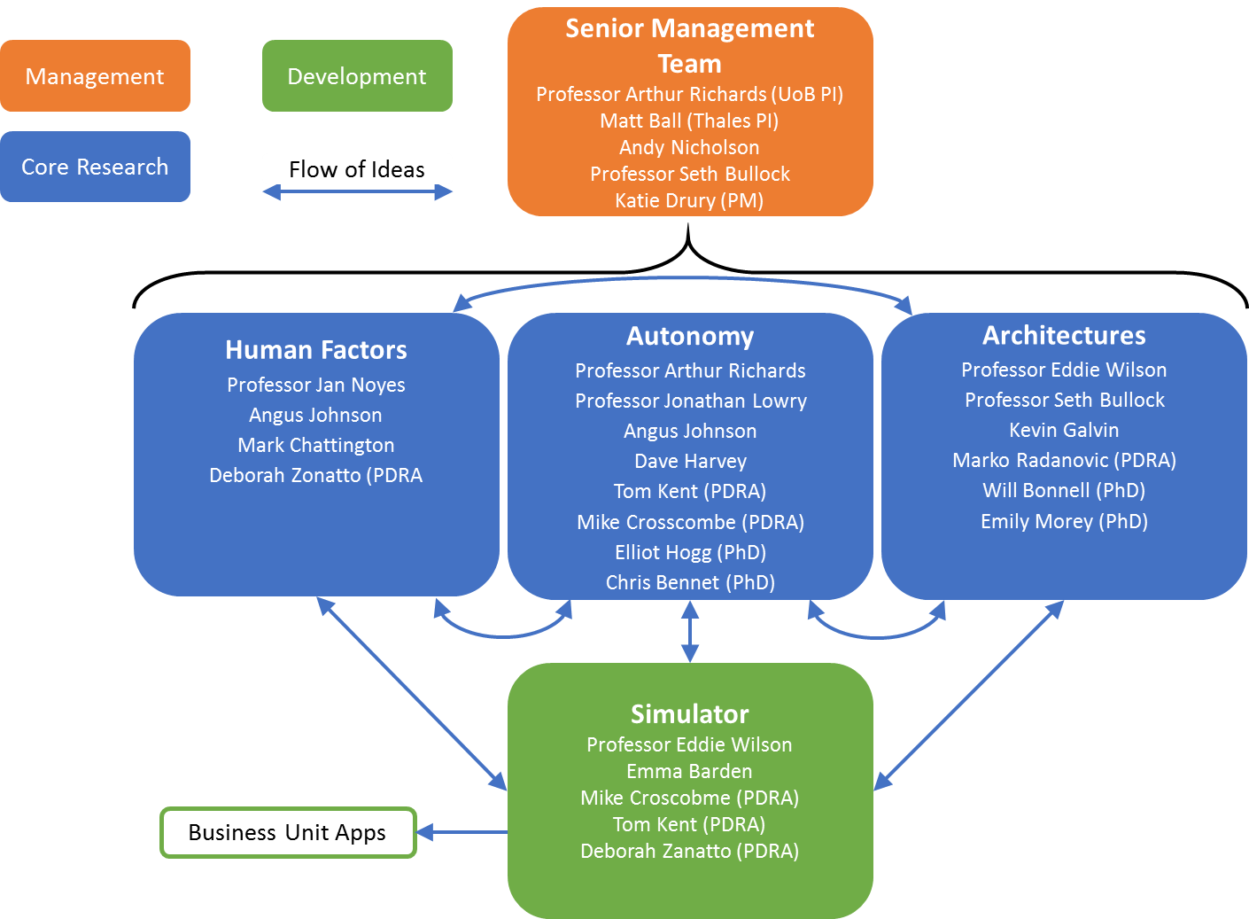
TB-PHASE
Vision
To deliver design principles and processes for hybrid (human-machine) autonomous systems engineering through a novel combination of fundamental research studies with application to Thales use cases:
Digital Rail
Maritime missions
Unmanned traffic management
At >£5M over 5 years, the Thales-Bristol Partnership in Hybrid Autonomous Systems Engineering (TB-PHASE) leverages £2.5M from EPSRC to harness leading academic thinking, pushing beyond the state of the art to deliver a step change in our understanding of how to deliver our vision for autonomy.
INTERNAL

Slide 4
THE ROLE OF TRUST
Trust is one of the key factors that determine whether an operator will choose to use automation:
Trust is a key component of a socio-technical approach to collaboration
Trust also impacts the relationship between human and cyber-physical elements, and the formation of hybrid systems
Trust encourages and ensures effective human-autonomy operations, particularly in dynamic and uncertain environments
Trust is necessary for the effective implementation of specific roles and responsibilities in a human-autonomous team
INTERNAL

Slide 5
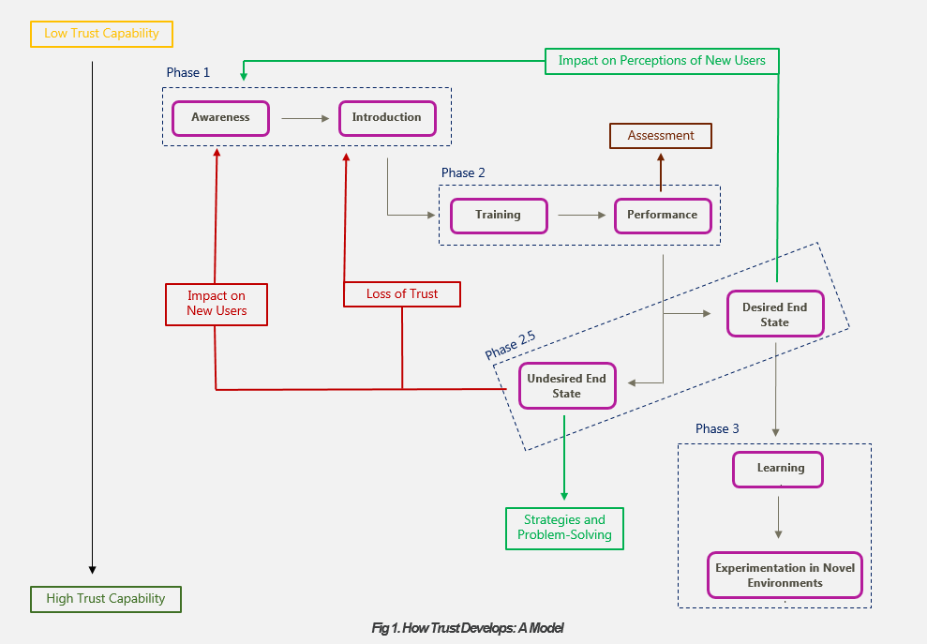
TRUST AS A PROCESS

Slide 6
BASIC DESIGN PRINCIPLES
Transparency: the human must be able to understand what the system is doing, and ask questions
Humans Involved in Decision Making: the human must be kept in the loop and continue to be involved in the task(s)
Ease of Interaction: the AI interface should be easy to engage with.
Training and Experience: training regarding the system would help the human work with it better.
Reputation and Regulation: the reputation of the manufacturer, familiarity with the technology and an understanding of the context helps with the development of trust.
In-Group Identity: trust is more likely to develop if teammates are perceived to be from the same group with common goals and values.
Rich Communication: the system will need to be able to engage in rich communication to convey information – the use of natural language increases the chances of its acceptance.
Agency: the system should be designed with anthropomorphic features and agency prior to being put in a partnership with a human.

Slide 8
DESIGN QUESTIONS
Is there transparent and rich communication from the system to the user?
Does the human still maintain some control when using the system?
Is the interface – and the system – easy to use?
If not, is there a process in place to train users?
Is there a chance that the system will develop a “bad reputation – how will that be handled?
Can the system be considered as being a teammate?
If not, how can it become a part of the team?

